Slide 1
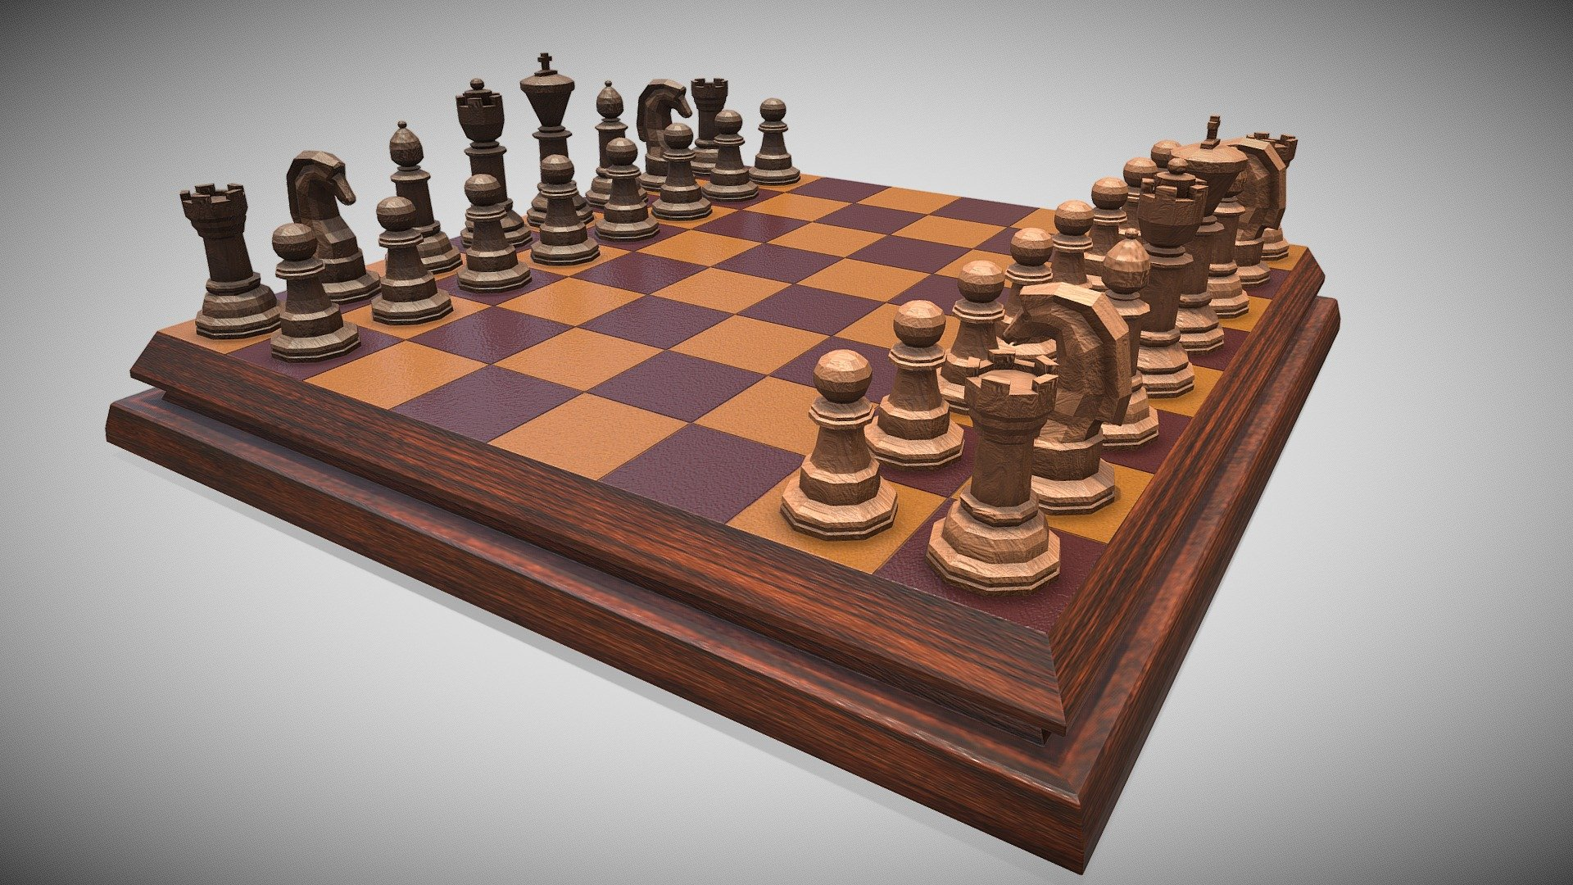
ONLINE CHESS GAME
Project By -
Amey Thakur & Mega Satish

Slide 2

AGENDA
What is Chess?
HMI Design Principles
Tools and Framework Used
Web Application Snapshot
Conclusion
References

Slide 3
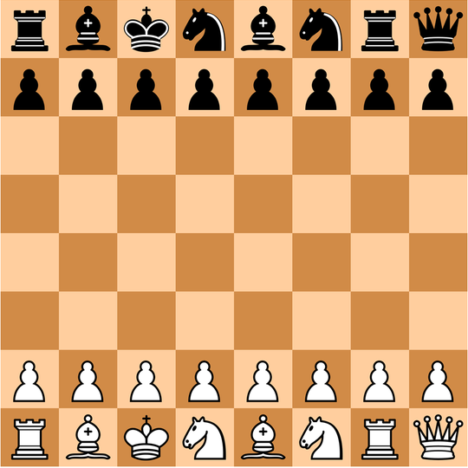
What is Chess?
Chess is a game for 2 players each of whom moves 16 pieces according to fixed rules across a checkerboard and tries to checkmate the opponent's king.
Chess is a mind game that involves a lot of thinking and time.
It requires prediction and problem-solving skills.

Slide 4
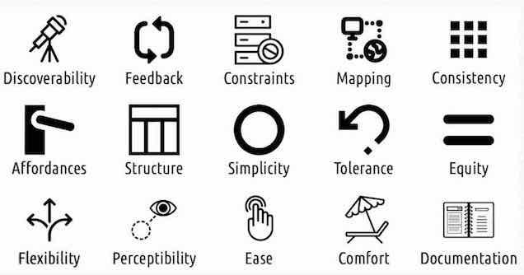
Human Machine Interaction Design Principles

Slide 5
Tools and Framework Used
NodeJS
Node.js is an open-source and cross-platform JavaScript runtime environment.
Nodejs was used for developing the application and creating the whole game.
Socket Programming
Socket programming shows how to use socket APIs to establish communication links between remote and local processes.
The concept of socket programming was applied here as the players can discuss with each other while playing chess.
Heroku
Heroku is an open-source software platform for machine learning and data science that makes it simple to develop and publish attractive, bespoke web apps.
The project was deployed on Heroku platform.

Slide 6
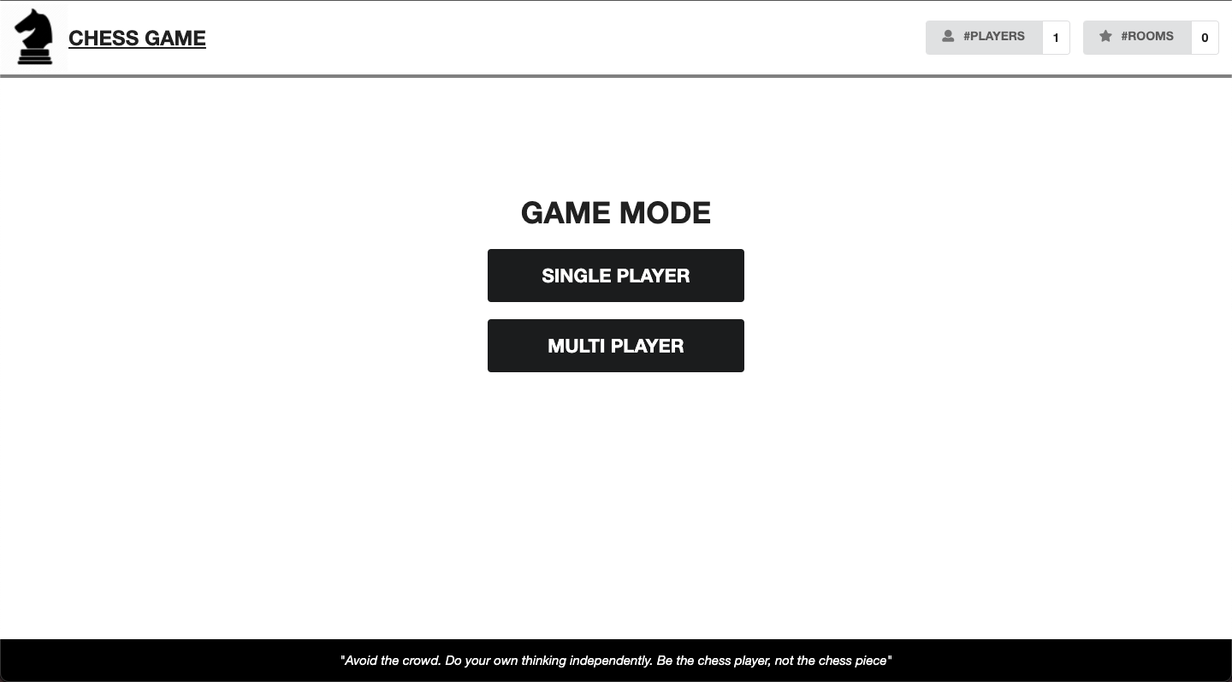
Snapshots
Home Page

Slide 7
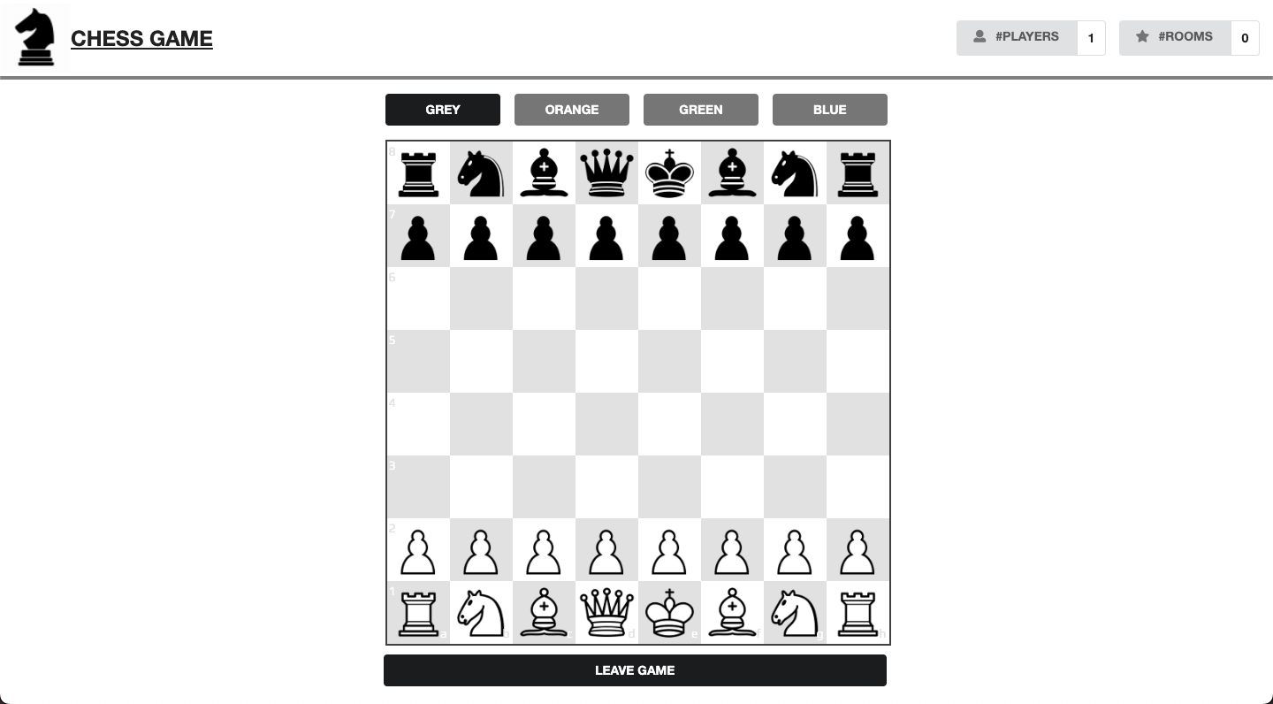
Snapshots
Single Player Mode

Slide 8
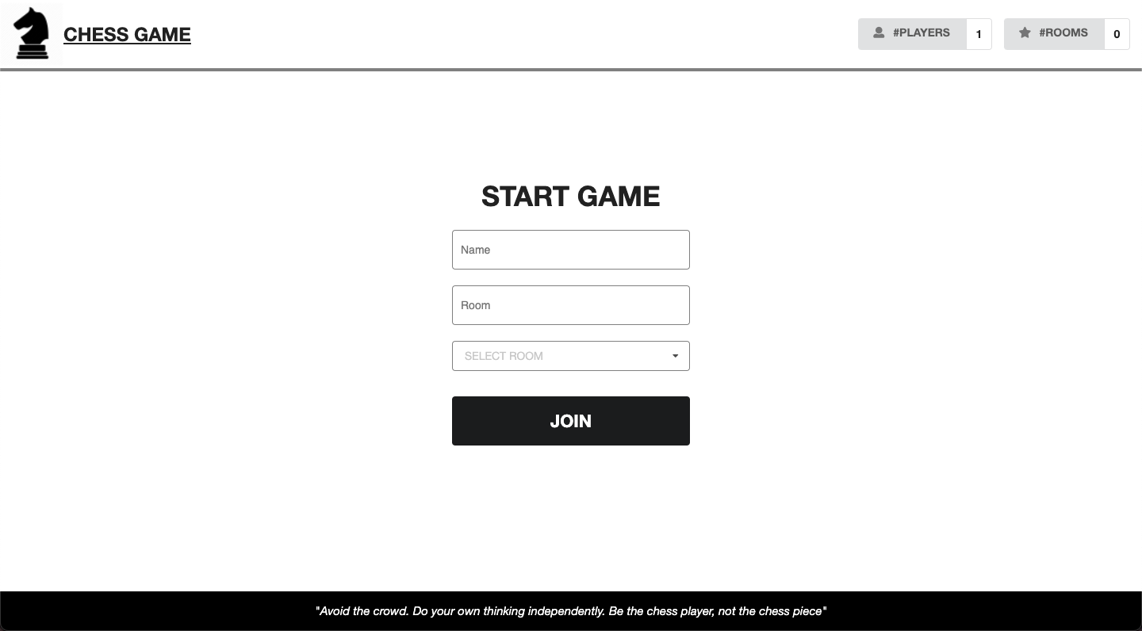
Snapshots
MultiPlayer Mode

Slide 9
Snapshots
MultiPlayer Mode

Slide 10

Snapshots
MultiPlayer Mode

Slide 11
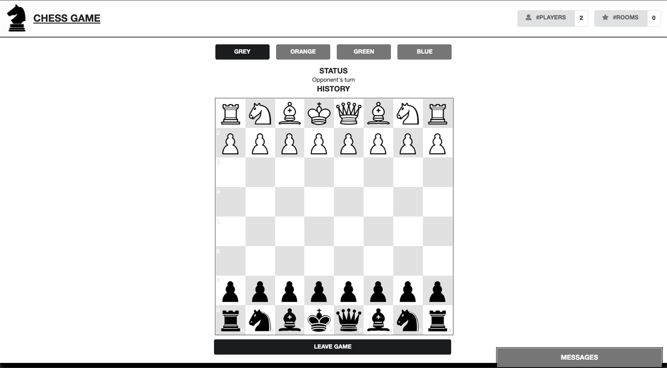
Snapshots
MultiPlayer Mode

Slide 12
Snapshots
MultiPlayer Mode

Slide 13
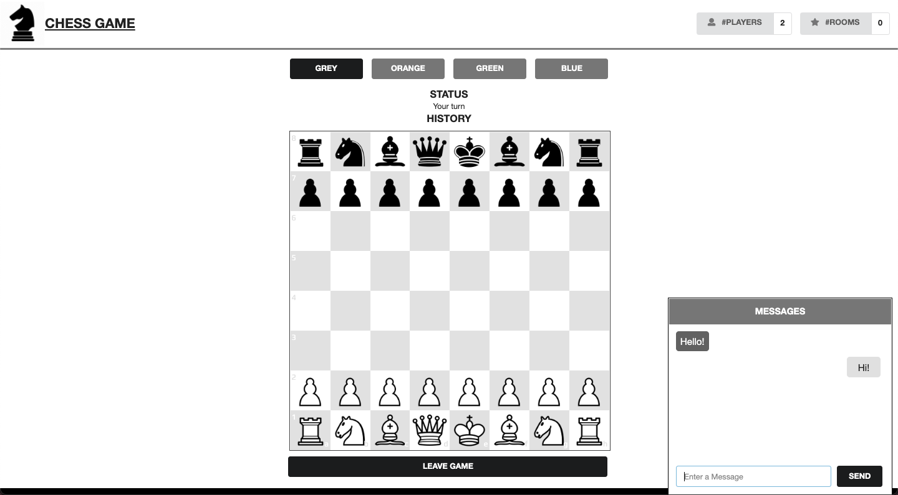
Snapshots
Chat window for players to send message to each other

Slide 14
Snapshots
Chat window for players to send message to each other

Slide 15
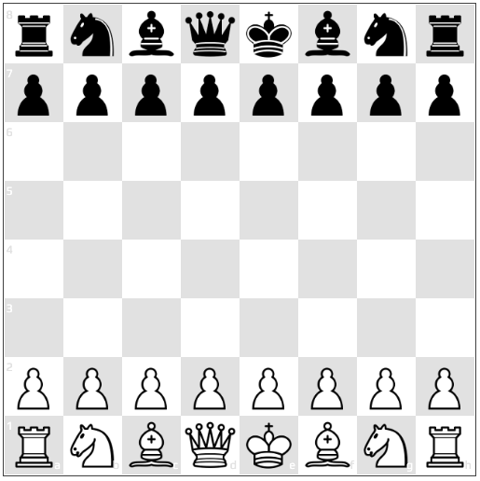
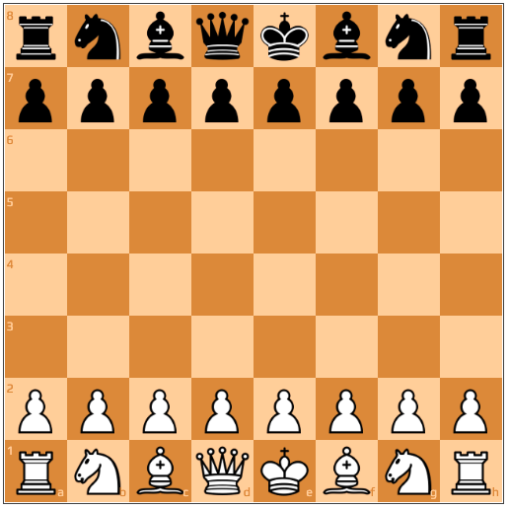
Snapshots
Colour Themes

Slide 16
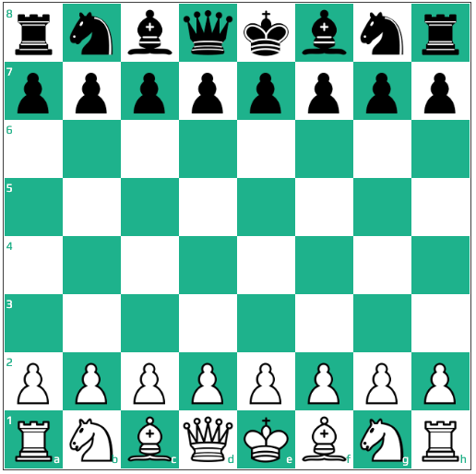
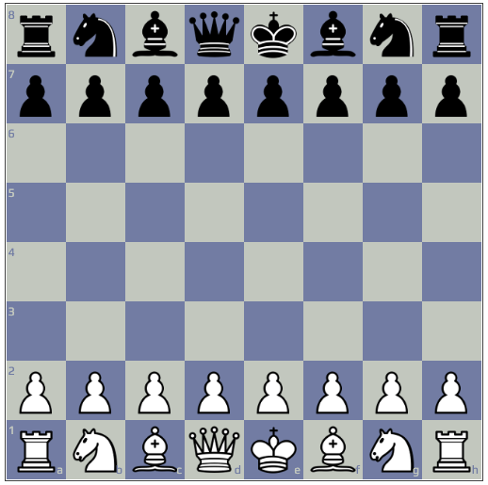
Snapshots
Colour Themes

Slide 17
Conclusion
Online chess game is designed by keeping in mind the Human Machine Interaction principles.
The web application is simple and allows the user to play chess. The user has the choice to change the theme of the game as well. While playing, the user gets to know about the possible movement of the pieces.
Two modes are available: single player and multiplayer. In case of multiplayer, the user can communicate with the opponent through a chat window. For multiple player mode, if the opponent leaves the game in the middle, the browser notifies that the opponent has left the game.

Slide 18
REFERENCES
[1] https://www.chess.com/terms/chess-pieces
[2] https://nodejs.org/en/docs
[3] https://devcenter.heroku.com/categories/reference
[4] https://devcenter.heroku.com/articles/getting-started-with-nodejs

Slide 19
THANK YOU

